Slide 1

Airbnb Data Analysis
Group 2: Project 1
Tim Cronin, Aliona Mizelle, Kate Vnuk, Stas Beynarovich
New York vs San Francisco 2018 Listings

Slide 2

Project Summary
Our project goal is to provide an analysis of Airbnb rental prices in New York and San Francisco over the 12-month period in 2018.
We’re interested in finding out if there is a correlation between prices and external factors including seasons, location, and day of the week.
High- level Hypothesis: San Francisco and New York are two of the most expensive real estate markets in the U.S. Given that San Francisco only has a population of 884K versus New York’s enormous 8.4M, San Francisco will have a much more expensive 2019 listing cycle than New York, with far fewer listing options and types.

Slide 3
Data Cleaning Process
Airbnb provides 3 segregated datasets for each respective city:
Listing
Calendar
Reviews
We read each CSV in Jupiter Notebook and grouped the data by price ranges and rental sizes (i.e. private bedroom, whole apartment, house).
We analyzed the data based on the seasonal rental volume (from lowest to highest), neighborhood/borough listing volume and price, average price by day of the week, as well as the correlation between price spikes and holiday weekends in 2019.
Finally we analyzed types of listings as they correlated to reviews.

Slide 4

Questions
What seasons are most in demand?
Which neighborhoods posit the most listings and for what types of rentals?
What are the most affordable days of the week to rent?
Are there patterns in popularity between different types of properties?
If I were to visit each city, which Holiday would be best to do so and why?
How do these trends compare between the two markets?

Slide 5
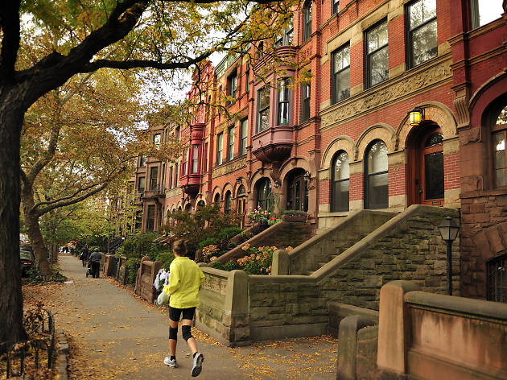
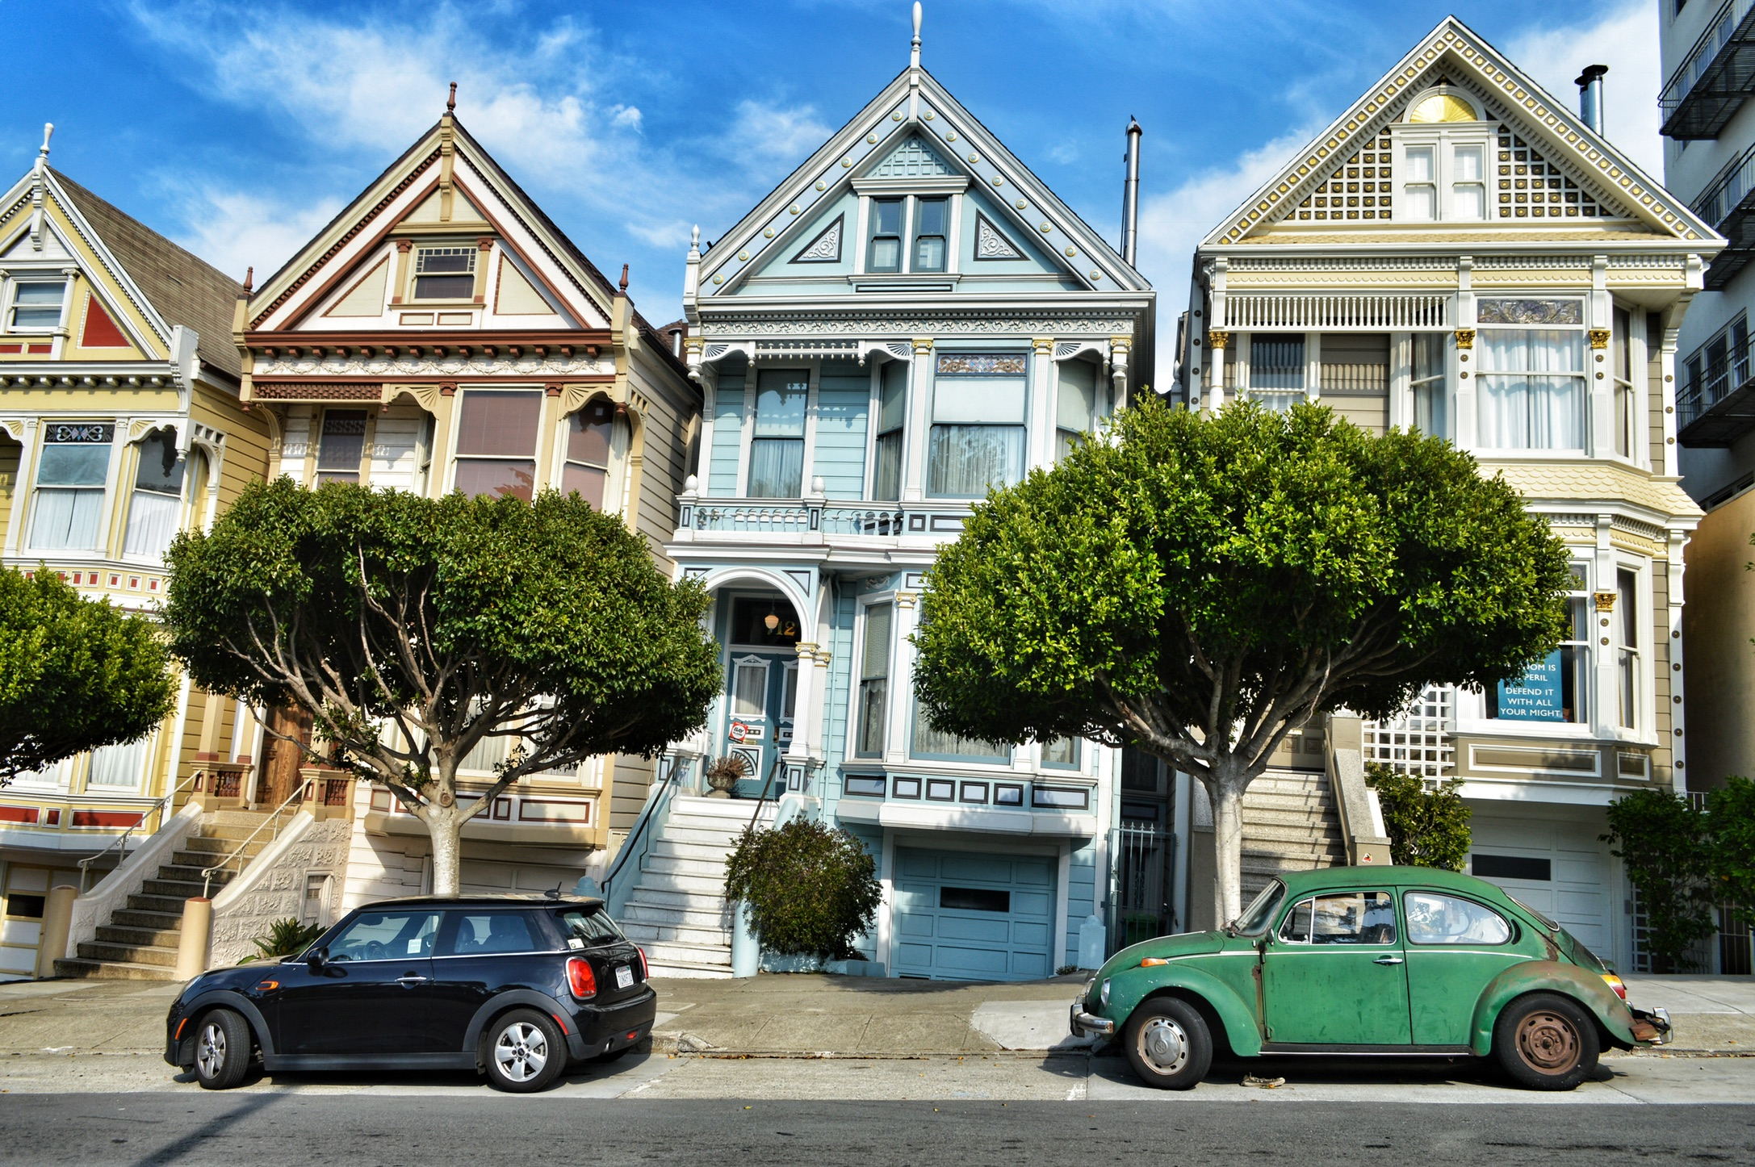
Data Analysis

Slide 6
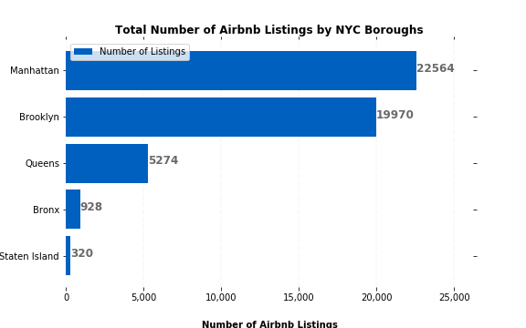
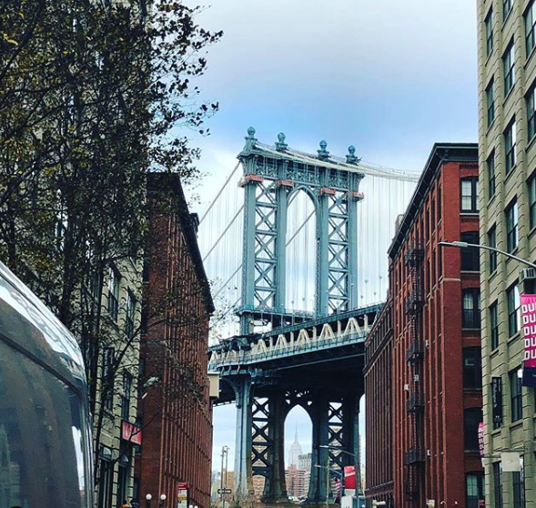
NY Borough Listings
Key Takeaway: Large drop-off between two top boroughs and the remaining three. Clear bias on where most renters are looking to stay.
Note: Brooklyn has larger population than Manhattan. Interesting that more listings took place on the island - likely because of sightseeing or tourist options

Slide 7
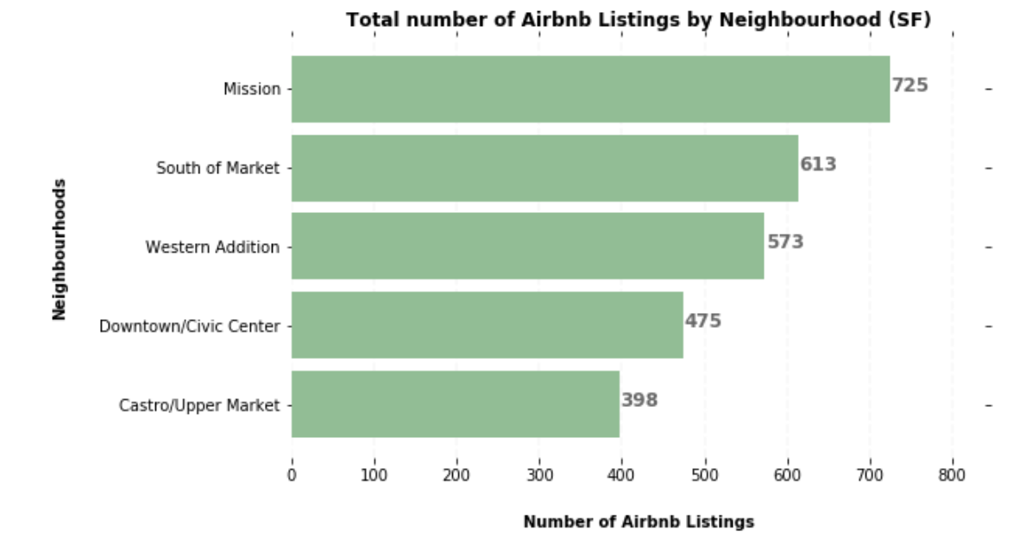
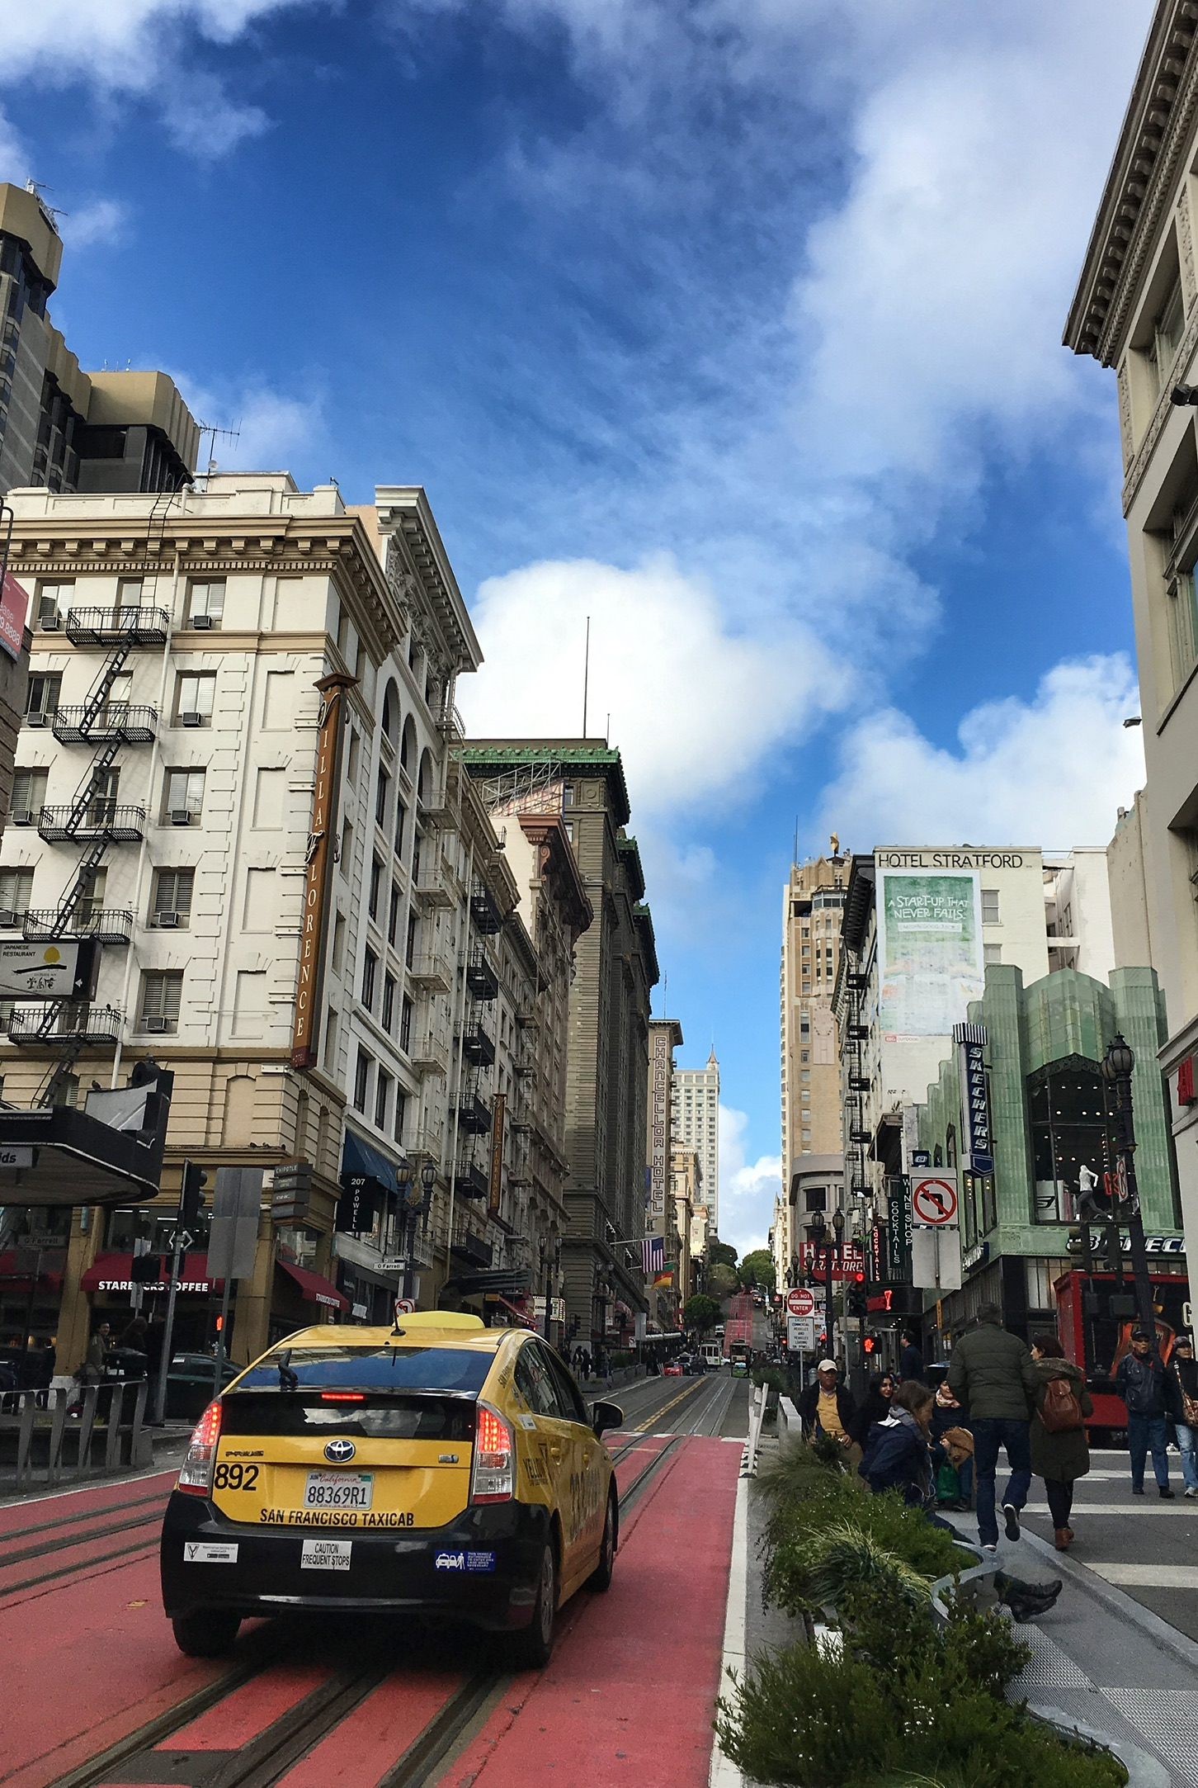
SF Top 5 Neighborhood Listings
Key takeaway:
The consolidation of listing areas provides a much less skewed number graph in SF vs NY
Mission has the most with #725
South of Market has just over 600 total listings
Western Addition had the third most with 573 total listings

Slide 8
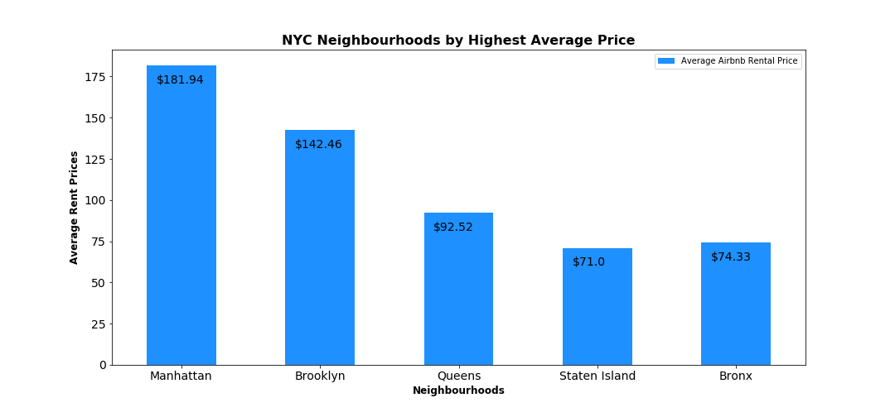
NY Borough Listings by Average Price
Takeaway: Much more expensive average/night in Manhattan than in Brooklyn, despite Brooklyn having nearly as many listings
Takeaway: Large drop-off between two top boroughs and the remaining three. Clear bias on where most renters are looking to stay.
Note: Bronx has 600 more listings this year, but a higher price average

Slide 9
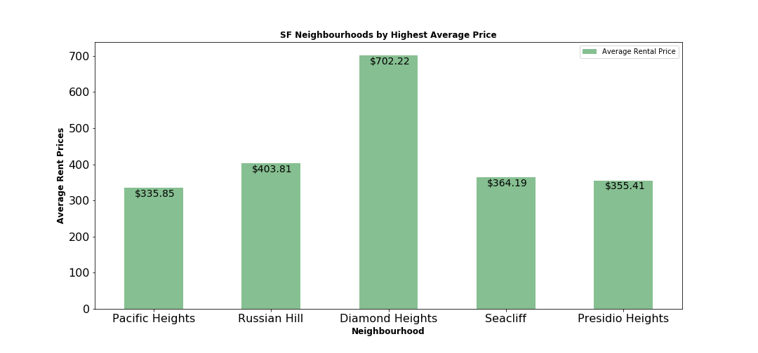
SF Neighborhoods Listings by Average Price
Key Takeaway: Far higher listing averages per night in SF than in NY. This shows us there is a neighborhood discrepancy in SF and a much higher price palate.

Slide 10
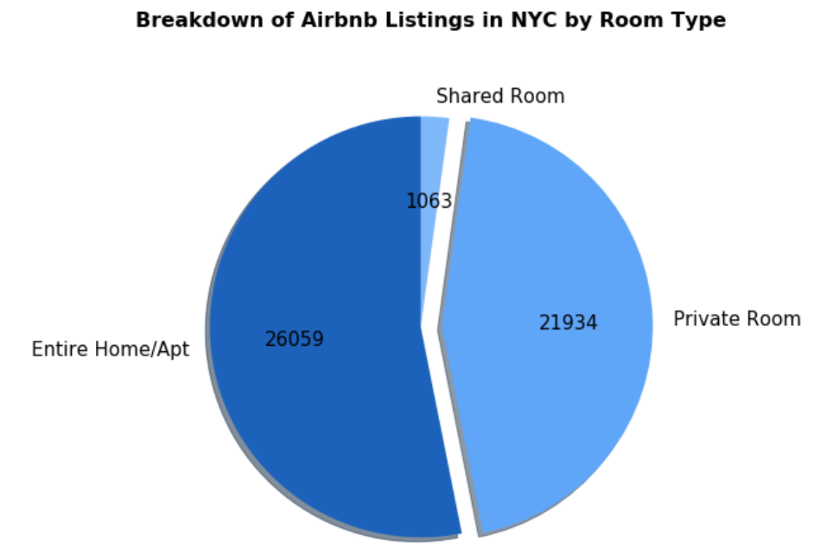
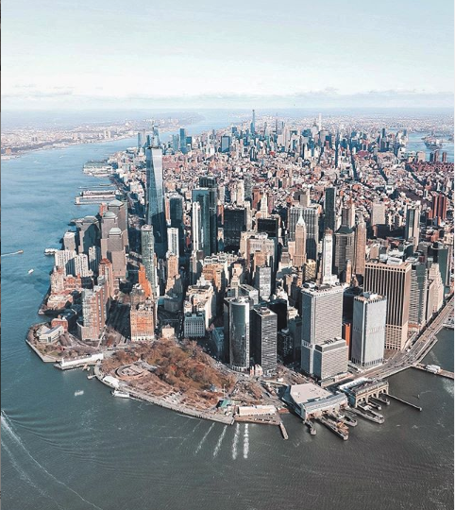
NY Listings by Room Type Visualization

Slide 11
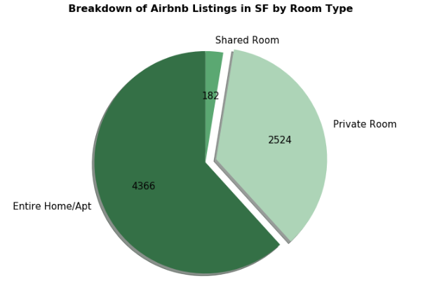

SF Listings by Room Type Visualization
Key takeaway: the discrepancy between home/apt vs private rooms in each market is similar, but more private room options in NY because of apartment layouts.

Slide 12
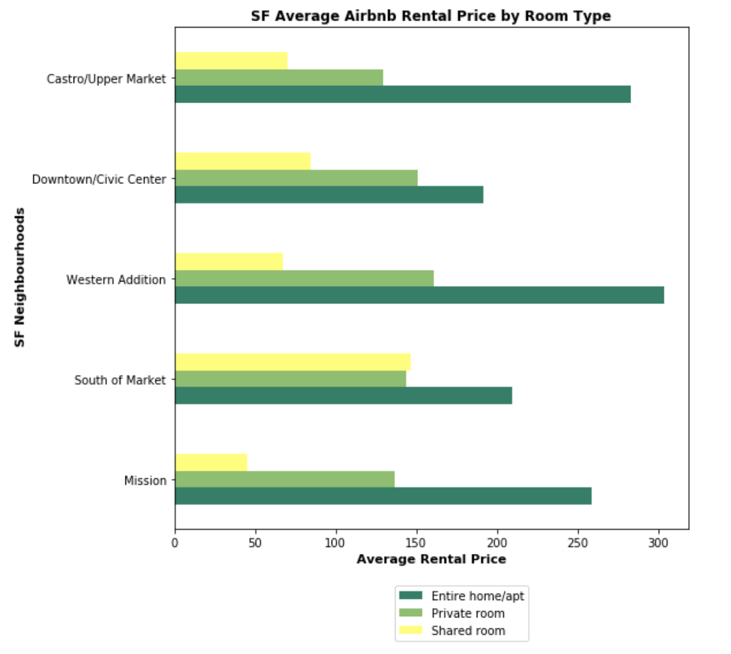
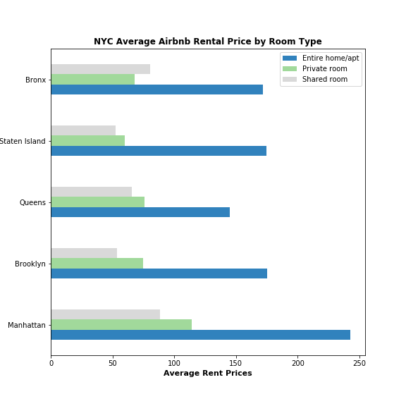
NY & SF Price by Room Types
Average price for entire home/apt is above 250/night in 3/5 top neighborhoods, where all 5 boroughs offer cheaper than that
Private room rentals are, on average more expensive per night in SF than in NY, with 4/5 Boroughs offering sub $100/night rental options

Slide 13
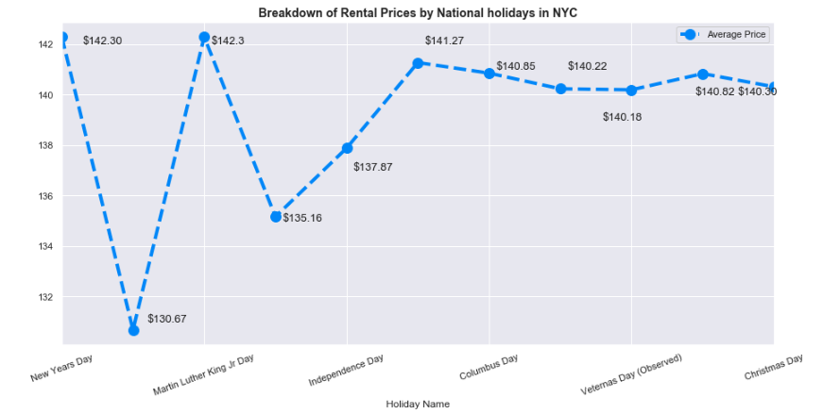
New York: Average Price by Holiday
Key Takeaways: New Years Day shows a high average price to rent Airbnb in New York ($142/night) followed by MLK Day (Jan 20th), with a nearly identical nightly average.
Interesting points:
The second and third least expensive holidays for Airbnb rentals in New York would be on two very popular ones: Memorial Day ( $135/night) and Fourth of July ($137/night).
The least expensive time to rent Airbnb in New York was during President’s Day (Monday, February 17th) last year for an average of $130/night.

Slide 14
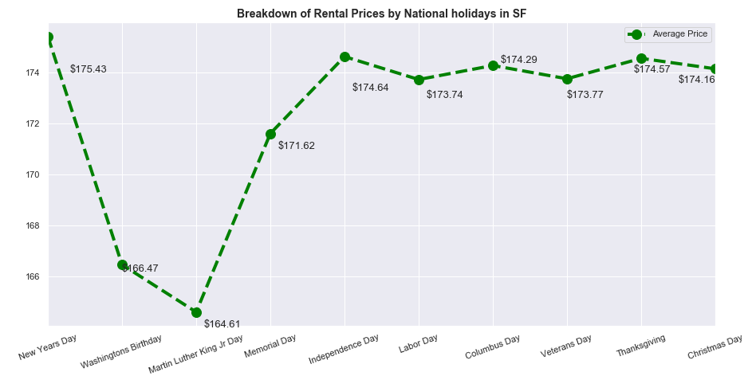
San Francisco: Average Price by Holiday
Key Takeaways:
New Years day was the highest average price/night to rent in SF, averaging $175/night
July 4th, Labor Day, Columbus Day, Veterans Day, Thanksgiving, and Christmas day were all roughly listed at the same price, between $173-$174/night

Slide 15
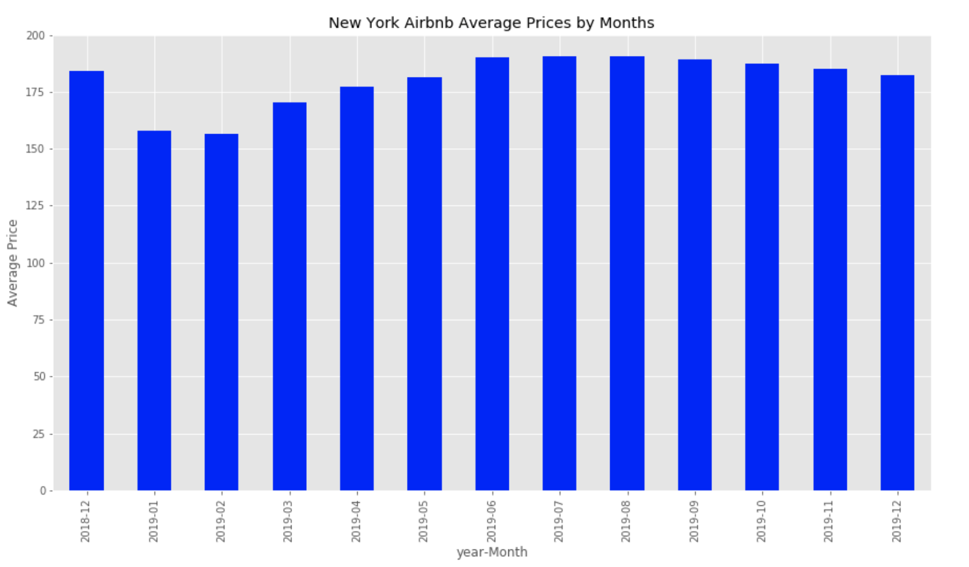
New York: Average Prices by Month
June-August are most expensive price/night to rent an Airbnb in NY
~$190/night each month
Interestingly, the fall was more popular than December ($187/night for Sept-Nov vs $183/night in December)
Unsurprisingly, the least expensive time to rent Airbnb in New York in Jan-Feb, with an average of $157/night

Slide 16
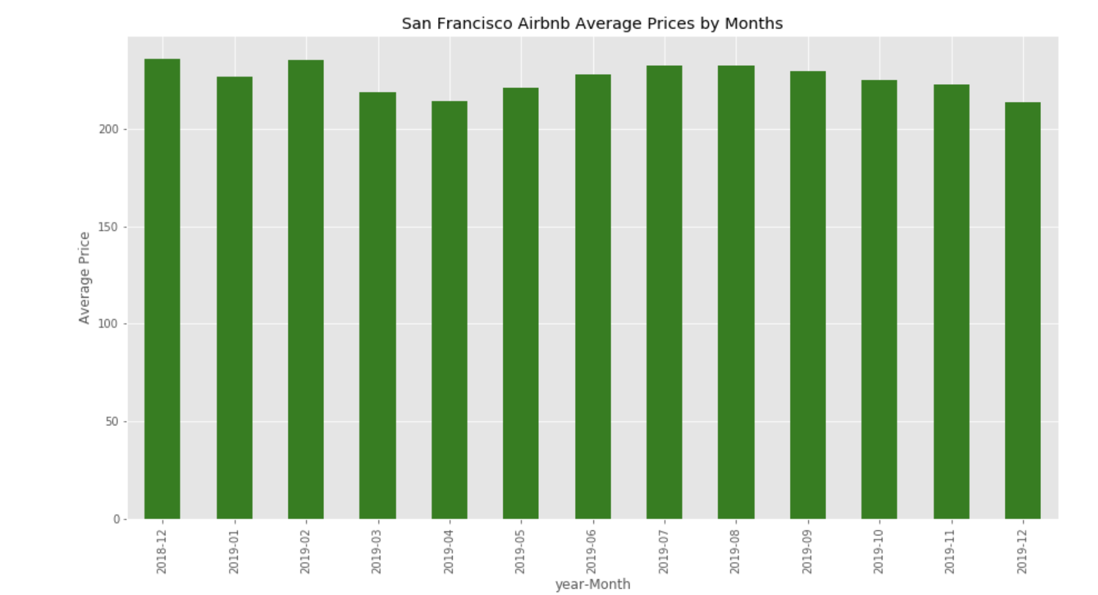
San Francisco: Average Prices by Month
December is the most expensive price/night to rent an Airbnb in San Francisco
~$235/night each month
Interestingly, the second most expensive month on average was February at a similar $235/month
The least expensive time to rent Airbnb in San Francisco is in April, with an average of $214/night

Slide 17
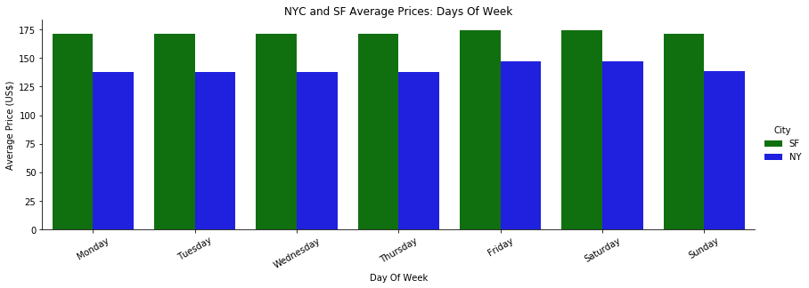
NYC vs SF: Average Prices by Day of the Week

Slide 18

Average Price by Day-of-the-Week Takeaways:
SF Market -
Unsurprisingly, Fridays & Saturdays are the most expensive average night to rent, with an average of $175/night. Interestingly, the rest of the nights of the week are all listed at ~$171/night
NY Market -
Similarly, Fridays & Saturdays are the most expensive average night to rent, as is expected for weekend rental demands, with an average of $146/night on Friday and $147/night on Saturday.
Monday’s are the least expensive on average, with $137.88 average/night per listing
Key Takeaway: NY has nearly a $10/night jump between the rest of the week and Friday/Saturday. SF is only a $3/night difference.

Slide 19
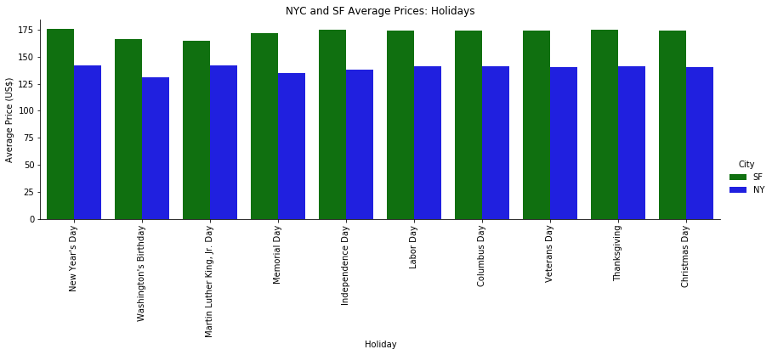
NYC vs SF: Average Price by Holiday

Slide 20
Summary Takeaways:
New Years day has a very high average price to rent in New York, averaging $142/night, followed interestingly by MLK Day at the end of that same month (Jan 20th), with a nearly identical nightly average.
Interestingly, the third and second least expensive Holiday’s you’d find renting in New York would be on two very popular ones: Memorial Day, for $135/night and Fourth of July for $137/night.
4th of July fell on a Thursday this year
Memorial Day fell on a Monday this year
The least expensive time to Airbnb in New York in 2019 was during President’s Day (Monday February 17) last year for an average of $130/night)
Interestingly, the third and second least expensive HoNew Years day was the highest average price/night to rent in SF, averaging $175/night
July 4th, Labor Day, Columbus Day, Veterans Day, Thanksgiving, and Christmas day were all roughly listed at the same price, between $173-$174/night in San Francisco

Slide 21
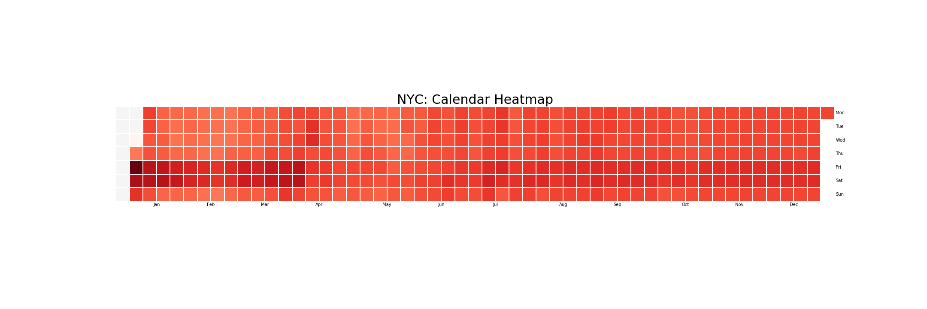
NYC: Calendar Heatmap

Slide 22
Calendar Takeaways:
Far more expensive Airbnb listings in SF than NY in 2019
Much different popular months between SF and NY in 2019
NY has nearly a $10/night jump between the rest of the week and Fri/Sat. SF is only $3/night
MLK day was the second most expensive day to rent in NY, least expensive to rent in SF
Could speak to types of renter visiting, seasonally
July 4th, Labor Day, Columbus Day, Veterans Day, Thanksgiving, and Christmas day were all roughly listed at the same price, between $173-$174/night in San Francisco
Key observation: Primarily purpose of Airbnb is not to provide a luxury hotel suites but convenient place to stay that is private.

Slide 23
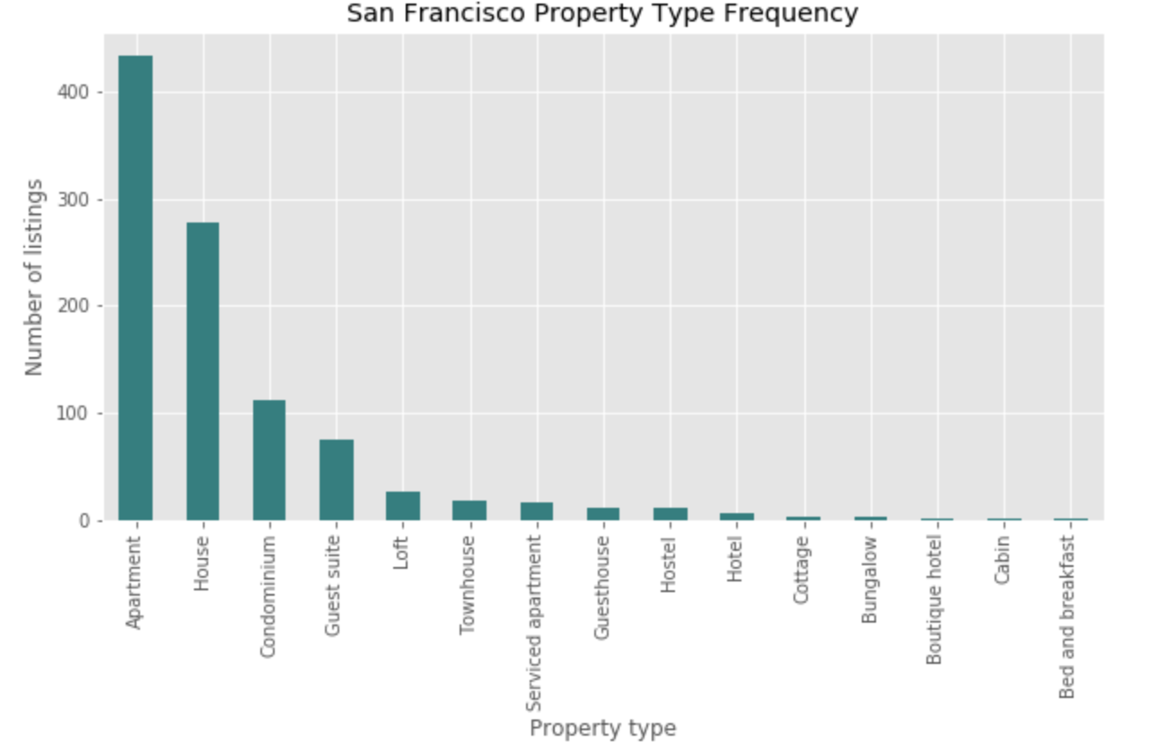
SF Property Type Frequency
The most frequently listed home types are the following top 3:
Apartments
Houses
Condominium
Key takeaways: Always consider the property and the room type data as one of the major aspects when predicting the prices of listings.

Slide 24
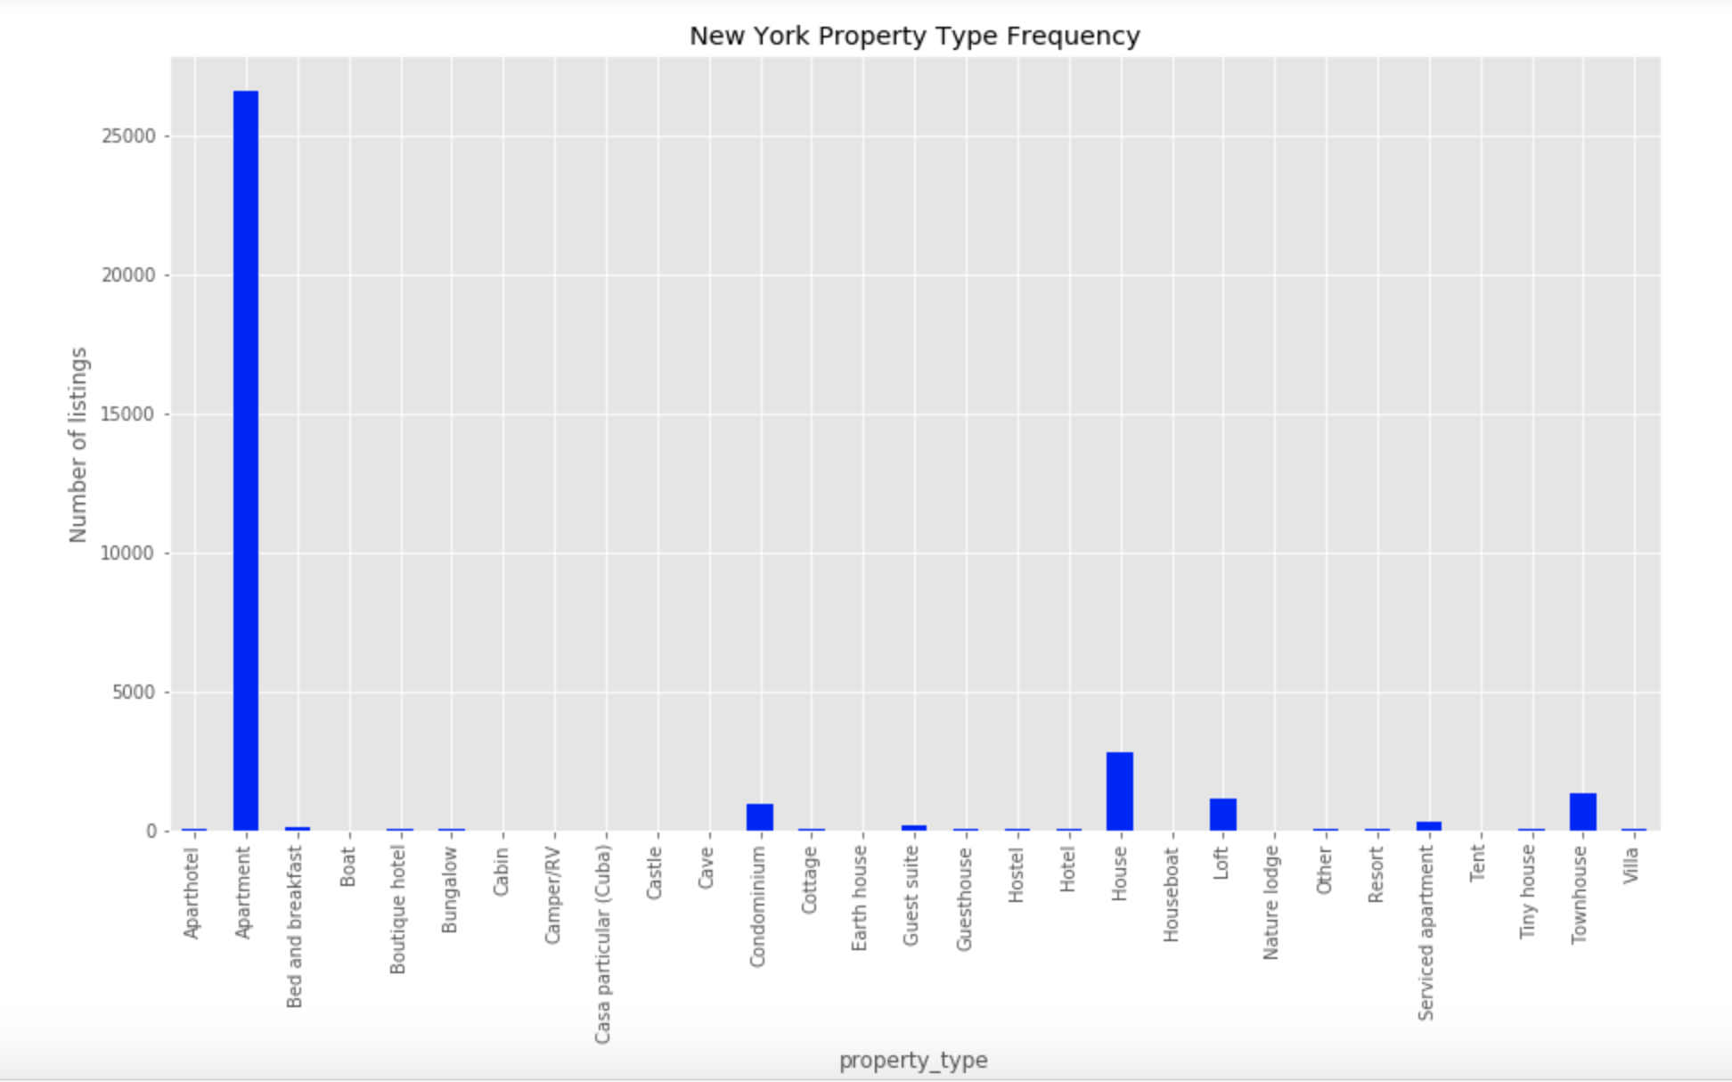
N Y Property Type Frequency
The most frequently listed home types are the following top 3:
Apartments
Condo's
Condominium
Key takeaways: Always consider the property and the room type data as one of the major aspects when predicting the prices of listings.

Slide 25
SF/NY Analysis by <keywords>
The most commonly used unique words when hosts describing their homes:
Keyword top results: <private>, <1 bedroom>, <home>.
Based on that data analysis Airbnb would know which room types are rented more often in order to optimize the revenue.

Slide 26
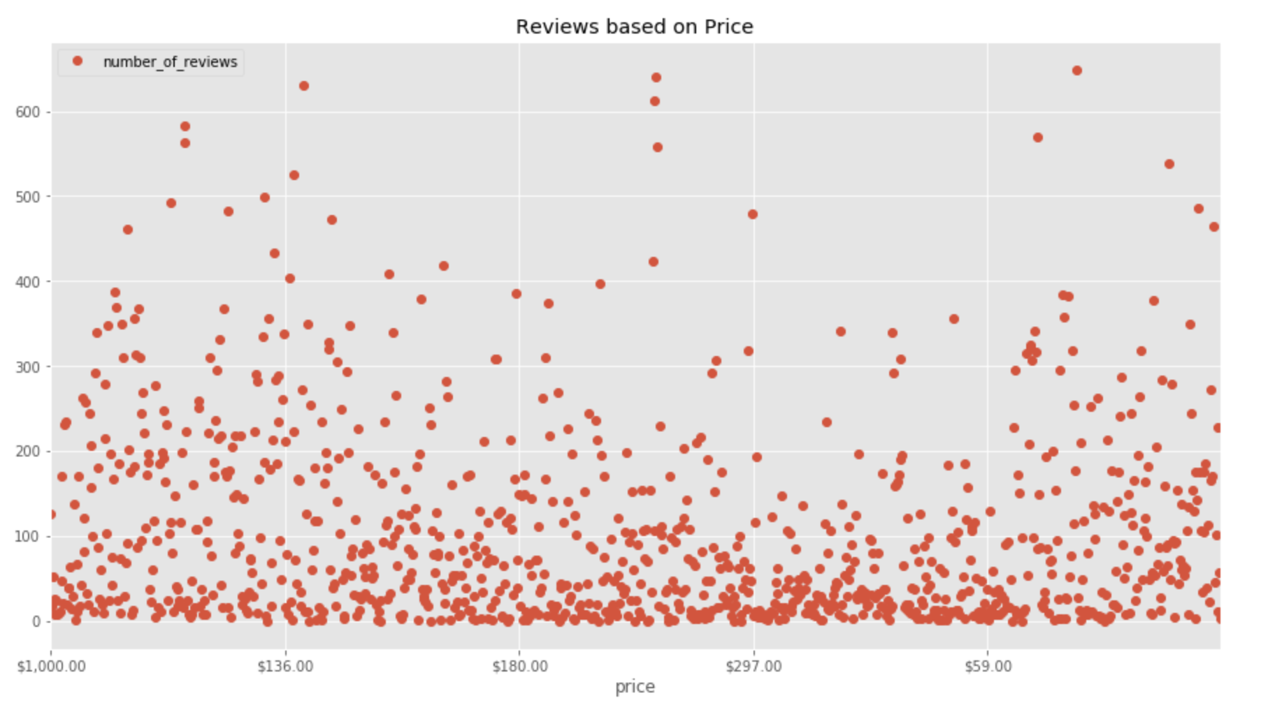
SF/NY Reviews Impact
Key takeaways: Listings with prices around $180 - 300 get the most reviews, meaning that they are booked most often.
Note: NY & SF review impact is similar in both markets

Slide 27
Post Mortem:
Difficulties & Limitations
Population discrepancy
Breadth of datasets - as mentioned, SF and NY have much differently defined residential regions. As such, the findings didn't particularly compare where we thought they might
It might have been effective to pinpoint top neighborhoods in 1 borough and compare to all of SF
Additional Questions worth Exploring
What is the primary driver of price hikes in certain neighborhoods? I.E. relationship to tourist attractions, good restaurants etc...
What is the profile of an ideal renter in certain neighborhoods - consumer profiles?

Slide 28
Questions?

Slide 29
Thank you!

